Slide 1
IS3313 Server Virtualization
Dr John O’Donoghue

Slide 2
Outline
What is Virtualization?
Why would you want to virtualize servers?
Why is virtualization difficult?
Three approaches to virtualization?
VmWare vSphere
Microsoft Hyper-V

Slide 3
What is Virtualization?
Is technology that emulates a hardware platform and allows multiple instances of an OS (or Oss) to use that platform, as though they have full and exclusive access to the underlying hardware
Proc 1
Proc 2
Proc 3
Proc 3
Proc 1
Proc 2

Slide 4
What is Virtualization?
Applications
Applications
Applications
Applications
OS 1
OS 2
OS 3
OS 4
Virtualization Platform
Hardware

Slide 5

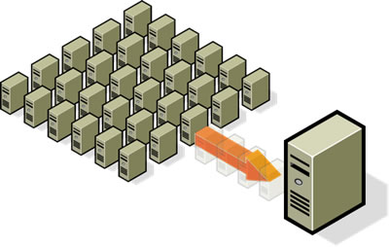
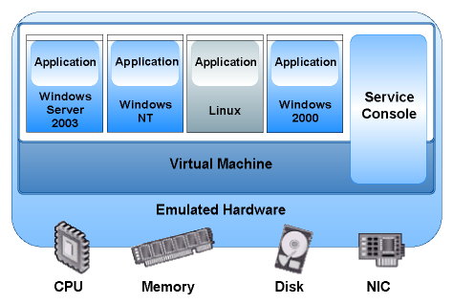
Why is Virtualization useful?
Server Consolidation
Servers typically support just 1 major application
Poor isolation between application instances
Low CPU usage - as low as 10-15% typically
Strong isolation between VMs
Virtualization saves on hardware & energy
Provisioning
Legacy systems
Migration
Disaster Recovery
High Availability
Testing and Deployment

Slide 6
Why Virtualize Servers?
Server virtualization conserves space through consolidation. If several applications only use a small amount of processing power, the network administrator can consolidate several machines into one server running multiple virtual environments. For companies that have hundreds or thousands of servers, the need for physical space can decrease significantly.
Server virtualization provides a way for companies to practice redundancy without purchasing additional hardware. Redundancy refers to running the same application on multiple servers. It's a safety measure -- if a server fails for any reason, another server running the same application can take its place. This minimizes any interruption in service.
Rather than buying a dedicated physical machine, network administrators can create a virtual servers with existing machines, thereby making provisioning faster and more effective and efficient.
Virtual servers offer programmers isolated, independent systems in which they can develop and test new applications or operating systems. Because each virtual server is independent in relation to all the other servers, programmers can run software without worrying about affecting other applications.

Slide 7
Why Virtualize Servers?
Server hardware will eventually become obsolete, and switching from one system to another can be difficult. In order to continue offering the services provided by these outdated systems -- sometimes called legacy systems -- a network administrator could create a virtual version of the hardware on modern servers. From an application perspective, nothing has changed. The programs perform as if they were still running on the old hardware. This can give the company time to transition to new processes without worrying about hardware failures, particularly if the company that produced the legacy hardware no longer exists and can't fix broken equipment.
An emerging trend in server virtualization is called migration. Migration refers to moving a server environment from one place to another. With the right hardware and software, it's possible to move a virtual server from one physical machine in a network to another. Originally, this was possible only if both physical machines ran on the same hardware, operating system and processor. It's possible now to migrate virtual servers from one physical machine to another even if both machines have different processors, but only if the processors come from the same manufacturer.

Slide 8
Why is virtualization difficult?
OS uses kernel mode / user mode transitions to protect the OS.
System calls (privileged instructions, API calls to executive or kernel functions, device drivers etc.) generate a trap (software interrupt) that forces a switch to kernel mode
These calls trigger sensitive instructions (CPU scheduling, I/O etc.) that must only be executed by the kernel

Slide 9
The Problem
If a VM runs in user space, it cannot run sensitive instructions, since those must trap to kernel space.
Solved in 2005 with new CPU Architectures and instruction set extensions
Intel Core 2 – VT (Virtualization Technology)
AMD Pacific – SVM (Secure Virtual Machine)
Provides new instructions that allow VM to capture traps

Slide 10
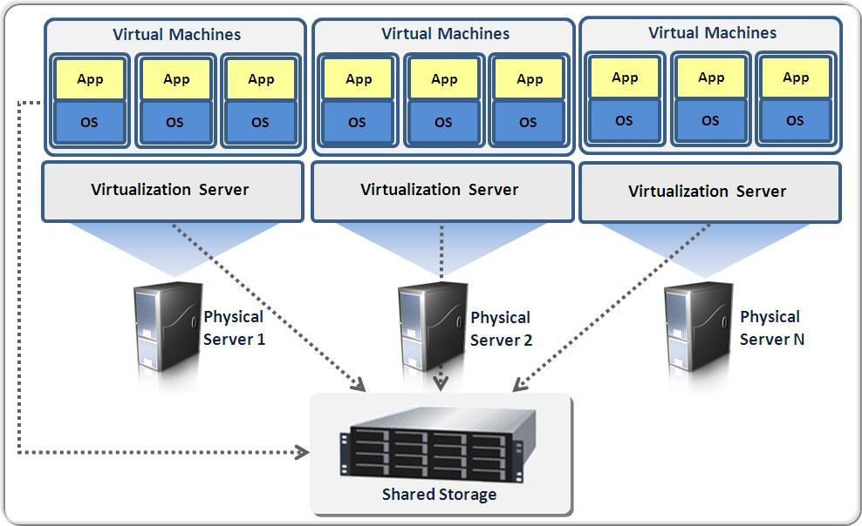
Three approaches to Virtualization
Type 1 Hypervisor: Hardware Emulation
Type 2 Hypervisor: Operating System
Paravirtualization: Hybrid

Slide 11
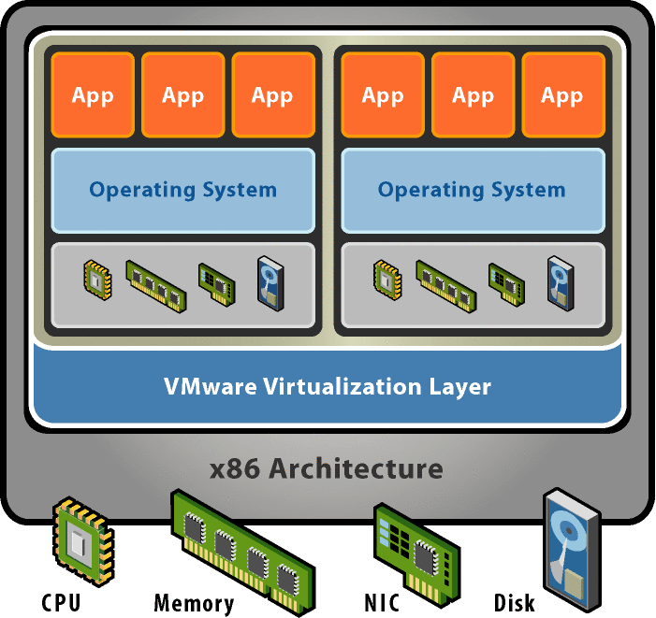
Type 1 Hypervisor: Hardware Emulation
Runs on “bare metal”
Binary translation
Virtual machines run in user mode
VM runs the guest OS (which thinks it is running in kernel mode) – Virtual kernel Mode
If guest OS calls sensitive instructions, hypervisor will trap and execute the instructions.
If application on guest OS calls sensitive instructions (system calls), hypervisor traps to guest OS.

Slide 12
Type 1 Hypervisor: Hardware Emulation
Not only does this approach support multiple OSs, it can support dissimilar OSs, differing in minor ways (for example, version and patch level) or in major ways (for example, completely different OSs like Windows and Linux can be run simultaneously in hardware emulation virtualization software).
Hardware emulation is also used in server consolidation, where a number of operating system/application environments are moved from separate physical servers to a single physical server running virtualization software.
Applications often run somewhat slower on virtualized systems than if they were run on unvirtualized systems.
The virtualization software presents a standardized hardware interface (the VMM) to the guest operating system.
The hypervisor provides an interface to the VMM and then translates that into calls to the actual physical resources on the machine.
This means that the hypervisor must contain the interfaces to the resources of the machine; these resources are referred to as device drivers.
If you’ve ever installed new hardware in a PC, you know that you often have to install a device driver into the operating system so that the new hardware and the operating system can communicate.

Slide 13
Type 1 Hypervisor: Hardware Emulation
In hardware emulation, the virtualization software (usually referred to as a hypervisor) presents an emulated hardware environment that guest operating systems operate upon. This emulated hardware environment is typically referred to as a virtual machine monitor or VMM.
The VMM provides a standardized hardware environment that the guest OS resides on and interacts with. Because the guest OS and the VMM form a consistent package, that package can be migrated from one machine to another, even though the physical machines the packages run upon may differ.
The hypervisor, which resides between the VMM and the physical hardware, translates the calls from the VMM to the specific resources of the physical machine.
This approach to virtualization means that applications run in a truly isolated guest OS, with one or more guest OSs running, one per VMM.
The VMMs all reside on the virtualization hypervisor.

Slide 14
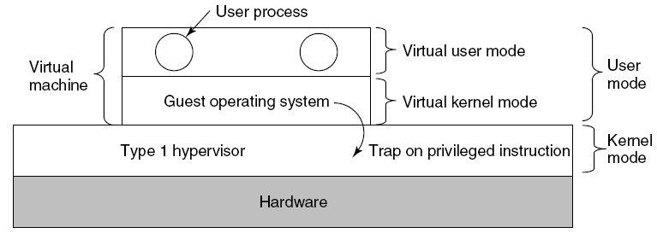
Type 1 Hypervisors: Hardware Emulation
When the operating system in a virtual machine executes a kernel-only instruction, it traps to the hypervisor if present.
Tanenbaum, Modern Operating Systems 3 e, (c) 2008 Prentice-Hall, Inc. All rights reserved. 0-13-6006639

Slide 15
Type 2 Hypervisor: OS Virtualization
Uses a host operating system
Supports guest OSs above it
OS-level virtualization approach doesn't use a hypervisor
Virtualization capability is part of the host OS, which performs all the functions of a fully virtualized hypervisor.
The biggest limitation of this approach is that all the guest servers must run the same OS
Each virtual server remains independent from all the others, but you can't mix and match operating systems among them. Because all the guest operating systems must be the same, this is called a homogeneous environment.

Slide 16
Operating system virtualization
Operating system (OS) virtualization (sometimes called containers) uses an existing host operating system and provides a set of libraries that virtual machine monitor (VMM) applications interact with, giving an application the illusion that it is (or they are, if there are multiple applications) running on a machine dedicated to its use.
From the application’s execution perspective, it sees and interacts only with those applications running within its virtual OS, and interacts with its virtual OS as though it has sole control of the resources of the virtual OS
This approach to virtualization is extremely useful if you want to offer a similar set of operating system functionalities to a number of different user populations while using only a single machine.
This is an ideal approach for Web hosting companies: They use container virtualization to allow a hosted Website to “believe” it has complete control of a machine, while in fact each hosted Web site shares the machine with many other Web sites, each of which is provided its own container.
Containerization usually means that the containers offer the same operating system as the host OS and even be consistent in terms of version number and patch level

Slide 17
Type 2 Hypervisor: OS Virtualization
Applications
Applications
Applications
Guest OS 1
Guest OS 2
Guest OS 3
Virtualization Platform
Applications
Host Operating System
Hardware

Slide 18
Paravirtualization
Paravirtualization is an efficient and lightweight virtualization technique introduced by Xen, later adopted by other virtualization solutions. It does not require virtualization extensions from the host CPU, and thus enables virtualization on hardware architectures that do not support hardware-assisted virtualization. However, control domains (e.g. host or privelegd OSs) paravirtualized guest OSs require kernel support and drivers that in the past required special kernel builds, but are now part of the Linux kernel as well as other operating systems.
Delivers higher performance than full virtualization because the operating system and hypervisor work together more efficiently, without the overhead imposed by the emulation of the system's resources.
Guest OSs in a paravirtualization system are aware of one another. A para-virtualization hypervisor doesn't need as much processing power to manage the guest operating systems, because each OS is already aware of the demands the other operating systems are placing on the physical server. The entire system works together as a cohesive unit.

Slide 19
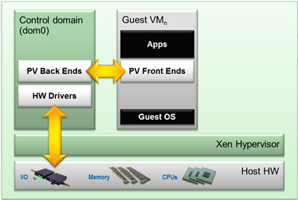
Paravirtualization
Modify Guest OS so that all calls to sensitive instructions are changed to hypervisor calls.
Much easier (and more efficient) to modify source code than to emulate hardware instructions (as in binary translation).
In effect, turns the hypervisor into a microkernel.

Slide 20
Paravirtualization
Rather than emulate a complete hardware environment, the virtualization software is a thin layer that multiplexes access by guest operating systems to the underlying physical machine resources.
It imposes less performance overhead because it is a very small amount of code.
Paravirtualization’s thin software layer acts more like a traffic cop, allowing one guest OS access to the physical resources of the hardware while stopping all other guest OSs from accessing the same resources at the same time.
Paravirtualization does not limit you to the device drivers contained in the virtualization software; in fact, paravirtualization does not include any device drivers at all. Instead, it uses the device drivers contained in one of the guest operating systems, referred to as the privileged guest.
Because it is lightweight and multiplexes access to the underlying hardware, paravirtualization requires that the guest operating systems be modified in order to interact with the paravirtualization interfaces.
Quad-Core AMD Opteron processors provide functionality that enables unmodified operating systems to be hosted by a paravirtualized hypervisor.

Slide 21
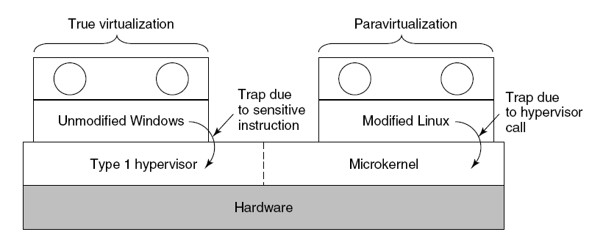
Paravirtualization (1)
A hypervisor supporting both true virtualization and paravirtualization.

Slide 22
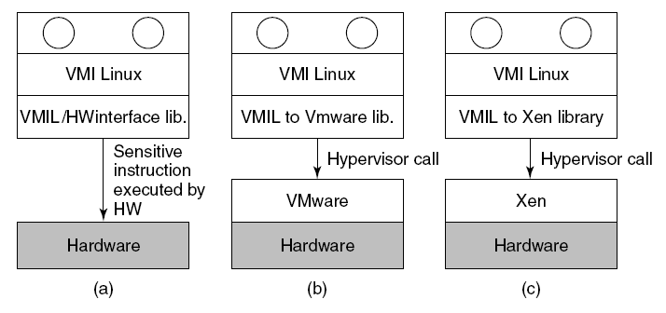
Paravirtualization (2)
VMI Linux running on (a) the bare hardware (b) VMware (c) Xen.
OS kernel modified so that it calls a special set of procedures to execute sensitive instructions (Virtual Machine Interface )
Bare metal – link to library that implement code
On VM – link to VM specific library

Slide 23
Virtualization Solutions
Microsoft – Virtual PC, Hyper-V
QEMU – Processor Emulation & VM
Sun Microsystems – xVM, VirtualBox
VMware – ESX Server, Workstation, Fusion, Player, Server, vSphere
Xen – Xen
VirtualIron

Slide 24
Memory Virtualization #1
In a traditional system there are typically 2 address spaces – the virtual address space (VAS) and the physical address space (PAS). The OS and user processes run in the VAS.
The OS manages the mapping from VAS to PAS through the use of the Virtual Memory Manager and the Memory Management Unit (MMU) provided in the processor.
The OS maintains a page table that maps each page in the current VAS to a page in the PAS.
Typically the OS will maintain one page table per user level process.

Slide 25
Memory Virtualization #2
The Virtual memory manager is responsible for allocating physical pages and mapping them to virtual addresses. If a machine has 4GB of RAM, the OS will know that it can allocate a million or so 4kB pages starting at offset 0. If you want to run more than one OS on the same hardware, a hypervisor will have to provide each of the guest OSs with the illusion of a more or less contiguous block of physical memory starting at address 0, because that’s what all OSs expect.
The simplest way to do that is to introduce one more level of virtualization — one more level of mapping between what the guest OS considers a physical address (it’s called guest physical address) and the actual physical address (which is called host physicaladdress). In other words, a virtual address is first translated to the guest physical address, and then to the host physical address — the latter translation controlled by the hypervisor.

Slide 26
I/O Virtualization
I/O virtualization allows I/O components to be separated, consolidated, and virtualized away from the physical confines of the server.
I/O components and peripheral devices are shared across many VMs and servers, for better utilization
It significantly reduce the number of I/O devices compared to a non-virtualized system.
Each guest OS holds its own I/O partition.

Slide 27
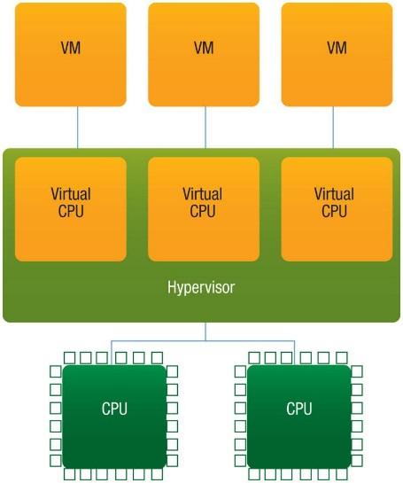
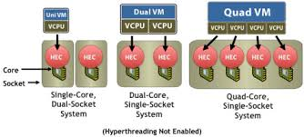
Virtual Machines on Multi-core CPUs
Each core can be configured for multiple virtual machines.
A Quad-core CPU could be configured as a 32 node multi-computer
Limiting factor is often memory. Each guest OS has its own requirements (512 MB?)

Slide 28
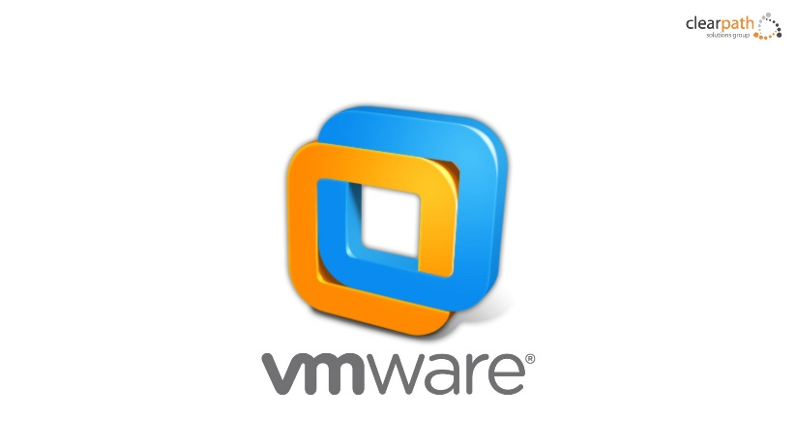
VMWARE

Slide 29
VmWare Solutions

Slide 30
Handling Privileged Instructions
In traditional systems OS runs in privileged mode
OS “owns” the hardware
Application code has less privilege
VMM needs highest privilege level for isolation and performance
Traditional VMM relies on “ring compression” or “de-privileging”
Run privileged guest OS code at user-level
Privileged instructions trap, and emulated by VMM

Slide 31
Vmware and hardware support
Key feature is new CPU execution mode (root mode)
VMM executes in root mode
Allows x86 virtualization without binary translation or paravirtualization
Guest state stored in Virtual Machine Control Structures (VT-x) or Virtual Machine Control Block (Pacifica)

Slide 32
VMware ESXi V-Sphere
Bare-metal architecture. VMware ESXi inserts a robust virtualization layer directly on the server hardware for near-native virtual machine performance, reliability and scalability
Small footprint. VMware ESXi is a compact, 144MB hypervisor. It is a fraction of the size of a general purpose operating system for unparalleled security and reliability
Server integration. VMware ESXi is available integrated into servers from leading OEM vendors for a simplified boot and deployment experience

Slide 33
vSPHERE Memory Management
RAM over-commitment. Increase memory utilization by configuring virtual machine memory that safely exceeds the physical server memory. For example, the sum of the memory of all virtual machines running on a server with 8GB physical memory can be 16GB.
Transparent page sharing. Utilize available memory more efficiently by storing memory pages identical across multiple virtual machines only once. For example, if several virtual machines are running Windows Server 2003, they will have many identical memory pages. Transparent page sharing consolidates those identical pages into a single memory location.
Memory ballooning. Shift memory dynamically from idle virtual machines to active ones. Memory ballooning artificially induces memory pressure within idle virtual machines, forcing them to use their own paging areas and release memory for active virtual machines.

Slide 34
VMware ESXi V-Sphere: Efficient resource virtualization
CPU virtualization. Run many operating systems and applications capsulated inside virtual machines on a single physical server for higher utilization, without risking critical processes being starved of compute or memory resources. VMware ESXi uses intelligent process scheduling and load balancing across available processors to manage the execution of virtual machine processing.
User-configurable Number of Virtual CPUs per Virtual Socket. GUI based configuration of virtual machines to have multiple virtual CPUsreside in a single virtual socket, with each virtual CPU appearing to the guest operating system as a single core.

Slide 35
Microsoft Hyper-V Architecture

Slide 36
Microsoft Hyper-V
Under Hyper-V hypervisor virtualization a program known as a hypervisor runs directly on the hardware of the host system in ring 0. The task of this Hypervisor is to handle tasks such CPU and memory resource allocation for the virtual machines in addition to providing interfaces for higher level administration and monitoring tools.
Clearly, if the hypervisor is going to occupy ring 0 of the CPU, the kernels for any guest operating systems running on the system must run in less privileged CPU rings.
Unfortunately, most operating system kernels are written explicitly to run in ring 0 for the simple reason that they need to perform tasks that are only available in that ring, such as the ability to execute privileged CPU instructions and directly manipulate memory. One solution to this problem is to modify the guest operating systems, replacing any privileged operations that will only run in ring 0 of the CPU with calls to the hypervisor (known as hypercalls). The hypervisor in turn performs the task on behalf of the guest system.
Another solution is to leverage the hardware assisted virtualization features of the latest generation of processors from both Intel and AMD. These technologies, known as Intel VT and AMD-V respectively, provide extensions necessary to run unmodified guest virtual machines.
In very simplistic terms these new processors provide an additional privilege mode (referred to as ring -1) above ring 0 in which the hypervisor can operate, essentially leaving ring 0 available for unmodified guest operating systems. the root partition contains the Virtualization Stack. This is a collection of components that provide a large amount of the Hyper-V functionality. The following diagram provides an abstract outline of the stack:

Slide 37
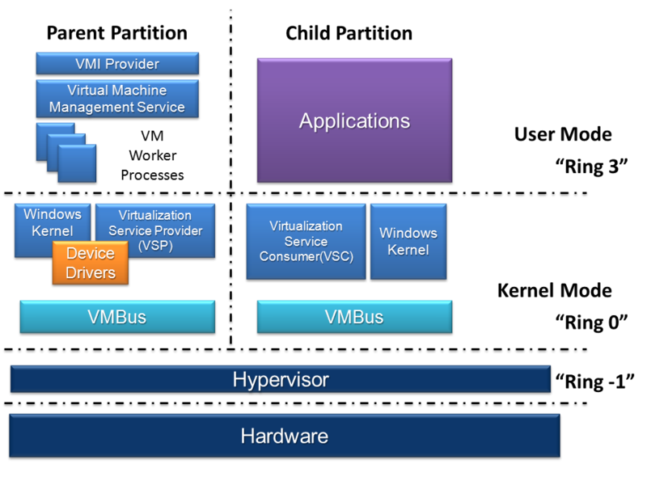
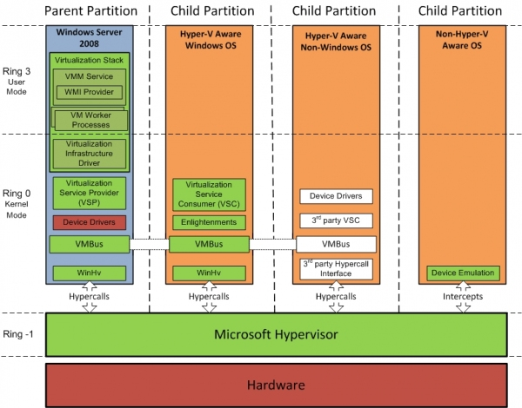
Microsoft Hyper-V

Slide 38
Hyper-V Architecture
Provided by:
OS
ISV / IHV / OEM
Microsoft Hyper-V
Parent Partition
Child Partitions
Microsoft / XenSource
Applications
Applications
Applications
VM Worker Processes
User Mode
WMI Provider
VM Service
Windows Server 2008
Windows Server 2003, 2008
Non-Hypervisor Aware OS
Xen-Enabled Linux Kernel
Windows Kernel
VSP
Windows Kernel
Linux VSC
VSC
IHV Drivers
VMBus
Kernel Mode
VMBus
VMBus
Emulation
Hypercall Adapter
Windows hypervisor
Ring -1
“Designed for Windows” Server Hardware

Slide 39

Why Not Get Rid Of the Parent Partition?
No defense in depth
Entire hypervisor running in the most privileged mode of the system
Virtual
Machine
Virtual
Machine
Virtual
Machine
User
Mode
User
Mode
User
Mode
Ring 3
Kernel
Mode
Kernel
Mode
Kernel
Mode
Ring 0
Scheduler
Memory Management
Storage Stack
Network Stack
VM State Machine
Virtualized Devices
Drivers
Management API
Ring -1
Hardware

Slide 40
Micro-kernelized Hypervisor
Defense in depth
Using hardware to protect
Hyper-V doesn’t use ring compression, uses hardware assists
Further reduces the attack surface
Parent Partition
Virtual
Machine
Virtual
Machine
VM State Machine
Virtualized Devices
Management API
User
Mode
User
Mode
Ring 3
Storage Stack
Network Stack
Drivers
Kernel
Mode
Kernel
Mode
Ring 0
Scheduler
Memory Management
Ring -1
Hardware

Slide 41
Component | Description
Virtual Machine Management Service (VMM Service) | Manages the state of virtual machines running in the child partitions (active, offline, stopped etc) and controls the tasks that can be performed on a virtual machine based on current state (such as taking snapshots). Also manages the addition and removal of devices. When a virtual machine is started, the VMM Service is also responsible for creating a corresponding Virtual Machine Worker Process.
Virtual Machine Worker Process | Virtual Machine Worker Processes are started by the VMM Service when virtual machines are started. A Virtual Machine Worker Process (named vmwp.exe) is created for each Hyper-V virtual machine and is responsible for much of the management level interaction between the parent partition Windows Server 2008 system and the virtual machines in the child partitions. The duties of the Virtual Machine Worker Process include creating, configuring, running, pausing, resuming, saving, restoring and snapshotting the associated virtual machine. It also handles IRQs, memory and I/O port mapping through a Virtual Motherboard (VMB).
Virtual Devices | Virtual Devices are managed by the Virtual Motherboard (VMB). Virtual Motherboards are contained within the Virtual Machine Worker Processes, of which there is one for each virtual machine. Virtual Devices fall into two categories, Core VDevs and Plug-in VDevs. Core VDevs can either be Emulated Devices or Synthetic Devices.
Virtual Infrastructure Driver | Operates in kernel mode (i.e. in the privileged CPU ring) and provides partition, memory and processor management for the virtual machines running in the child partitions. The Virtual Infrastructure Driver (Vid.sys) also provides the conduit for the components higher up the Virtualization Stack to communicate with the hypervisor.

Slide 42
Windows Hypervisor Interface Library | A DLL (named WinHv.sys) located in the parent partition Windows Server 2008 instance and any guest operating systems which are Hyper-V aware (in other words modified specifically to operate in a Hyper-V child partition). Allows the operating system’s drivers to access the hypervisor using standard Windows API calls instead of hypercalls.
VMBus | Part of Hyper-V Integration Services, the VMBus facilitates highly optimized communication between child partitions and the parent partition.
Virtualization Service Providers | Resides in the parent partition and provides synthetic device support via the VMBus to Virtual Service Clients (VSCs) running in child partitions.
Virtualization Service Clients | Virtualization Service Clients are synthetic device instances that reside in child partitions. They communicate with the VSPs in the parent partition over the VMBus to fulfill the child partition’s device access requests.

Slide 43
Microsoft Hyper-V Capabilities
32-bit (x86) & 64-bit (x64) VMs
Large memory support (64 GB) per VM
SMP VMs (up to 4 cores)
Integrated cluster support for HA & Quick Migration
BitLocker: Seamless, secure data encryption
Live Backup: Volume Shadow Service integration
Pass-through disk access for VMs
Virtual Machine snapshots
New hardware sharing architecture (VSP/VSC/VMBus)
Disk, networking, input, video
Robust networking: VLANs and NLB
Distributed Management Task Force (DMTF) standard for Windows Management Instrumentation (WMI), which is the infrastructure for management data and operations on Windows-based operating systems
Support for Full or Server Core installations

Slide 44
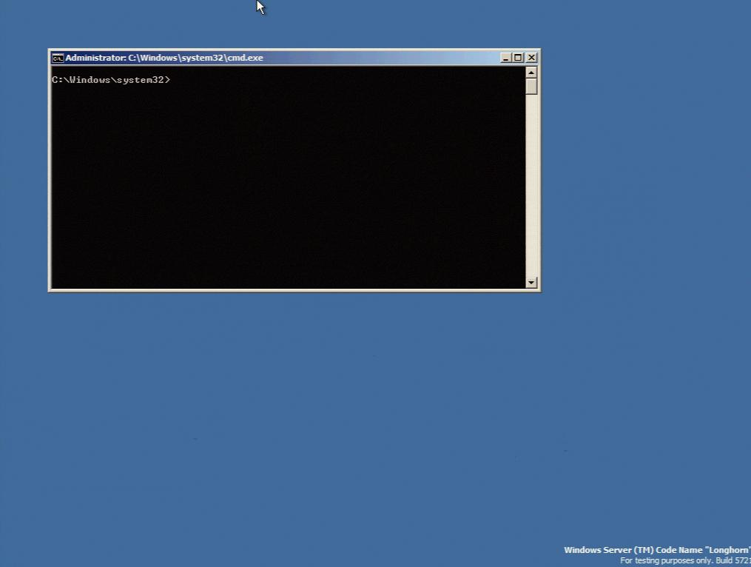
Windows Server Core
Server Core: New minimal installation option
Provides essential server functionality
Command Line Interface only, no GUI Shell
Benefits
Less code results in fewer patches and reduced servicing burden
Low surface area server for targeted roles
More secure and reliable with less management

Slide 45
Security
Isolation
No sharing of virtualized devices
Separate VMBus instance per vm to the parent
No sharing of memory
Each has its own address space
VMs cannot communicate with each other, except through traditional networking
Guests can’t perform DMA attacks because they’re never mapped to physical devices
Guests cannot write to the hypervisor
Parent partition cannot write to the hypervisor

Slide 46
Microsoft Hyper-V Networking

Slide 47
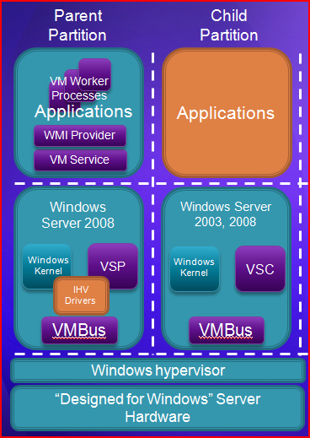
Microsoft Hyper-V Networking
Two physical network adapters at minimum
One for management
One (or more) for VM networking
Dedicated NIC(s) for iSCSI
Connect parent to back-end management network
Only expose guests to internet traffic

Slide 48
Hyper-V Network Configurations
Example 1
Physical Server has 4 network adapters
NIC 1: Assigned to parent partition for management
NICs 2/3/4: Assigned to virtual switches for virtual machine networking
Storage is non-iSCSI such as
Direct attach
SAS or Fibre Channel

Slide 49
Parent Partition
Child Partitions
Applications
Applications
Applications
VM Worker Processes
User Mode
WMI Provider
VM Service
Windows Server 2008
VM 1
VM 2
VM 3
VSP
Windows Kernel
VSC
Windows Kernel
VSC
Linux Kernel
VSC
VSP
VSP
Kernel
Mode
VMBus
VMBus
VMBus
VMBus
Windows hypervisor
Ring -1
“Designed for Windows” Server Hardware
Mgmt
NIC 1
VSwitch 1
NIC 2
VSwitch 2
NIC 3
VSwitch 3
NIC 4

Slide 50
Hyper-V Network Configurations
Example 2
Server has 4 physical network adapters
NIC 1: Assigned to parent partition for management
NIC 2: Assigned to parent partition for iSCSI
NICs 3/4: Assigned to virtual switches for virtual machine networking

Slide 51
Now With iSCSI
Parent Partition
Child Partitions
Applications
Applications
Applications
VM Worker Processes
User Mode
WMI Provider
VM Service
Windows Server 2008
VM 1
VM 2
VM 3
Windows Kernel
VSC
Windows Kernel
VSC
Linux
Kernel
VSC
VSP
VSP
Kernel
Mode
VMBus
VMBus
VMBus
VMBus
Windows hypervisor
Ring -1
“Designed for Windows” Server Hardware
Mgmt
NIC 1
iSCSI NIC 2
VSwitch 1
NIC 3
VSwitch 2
NIC 4

Slide 52
Summary
Virtualization provides a way to consolidate OS installations onto fewer hardware platforms
3 basic approaches
Two main vendors
VmWare vSphere
Microsoft Hyper-V
YOU NEED TO COMPARE AND CONTRAST THE TWO.

